Slide 1
HTML5 & Its New Features
Lesson 17: The Offline Access & Drag and Drop API

Slide 2

Lesson Objectives
In this lesson you will learn about:
Introduction to Offline Access in HTML5
Techniques of implementing Offline Access
Introduction to Drag & Drop API in HTML5
Techniques of implementing Drag & Drop API
Limitations of HTML5
Comparison – Native SDK & HTML5

Slide 3
Introduction to Offline Access in HTML5 What is an offline Access?
Web applications have become a major part of many people’s lives
It's becoming increasingly important for web-based applications to be accessible offline
All browsers have caching mechanisms, but they're unreliable and don't always work as you might expect
Wouldn't it be great if we could use them even when offline
Until recently, there wasn’t any viable way to do this
However, HTML5 introduces new methods for enabling a web site or web application to function without a network connection
Notes:
What is an Offline Web Application?
At first glance it sounds like contradictions in terms. Web pages are things you
download & render. Downloading implies a network connection. How can you
download when you are offline? Of course, you can’t. But you can download when
you are online. And that’s how offline applications work.
As we all know that, Web applications have become a major part of many people’s
Lives. It's becoming increasingly important for web-based applications to be
accessible offline. All browsers have caching mechanisms, but they're unreliable and
don't always work as you might expect. Wouldn't it be great if we could use them
even when offline. Until recently, there wasn’t any viable way to do this. However,
HTML5 introduces new methods for enabling a web site or web application to
function without a network connection.

Slide 4
Introduction to Offline Access in HTML5 Need for an Offline Access
Web applications are becoming more complex and capable every day
There are many examples of web applications doing the same job as desktop applications in various fields
For example Google Docs, Picasa, etc.)
However, one major disadvantage is that they cannot work when the user is not connected to the Internet
This is where HTML5's new offline storage comes in
It tries to remove that disadvantage
HTML5 achieves this by defining a way to store files in a cache, so that when the user is offline, the browser still has access to the necessary files
These can be HTML, CSS or JavaScript files, or any other assets the site needs to run
Notes:
Need for an Offline Access
Web applications are getting more advanced each day, with more elaborate uses of:
JavaScript as well as upcoming standards and technologies. We increasingly rely on
these applications, many of them becoming a part of our daily lives. There are many
examples of web applications doing the same job as desktop applications in various
Fields. For example Google Docs, Picasa, etc.
However, one major disadvantage is that they cannot work when the user is not
connected to the Internet.
It's becoming increasingly important for web-based applications to be accessible
offline. Yes, all browsers have caching mechanisms, but they're unreliable and don't
always work as you might expect.
This is where HTML5's new offline storage comes in It tries to remove that
disadvantage. HTML5 achieves this by defining a way to store files in a cache, so
that when the user is offline, the browser still has access to the necessary files.

Slide 5
Introduction to Offline Access in HTML5 How to implement an Offline Access in HTML5?
At its simplest, an offline web application is a list of URLs
This URL includes resources like HTML, CSS, JavaScript, images, or any other kind of resource
The home page of the offline web application points to this list, called a Manifest file, which is just a text file located elsewhere on the web server
A web browser that implements HTML5 offline applications will read the list of URLs from the manifest file
It also downloads the resources, cache them locally, and automatically keep the local copies up to date as they change
When the time comes that you try to access the web application without a network connection, your web browser will automatically switch over to the local copies instead
Notes:
How to implement an Offline Access in HTML5?:
At its simplest, an offline web application is a list of URLs. This URL includes
resources like HTML, CSS, JavaScript, images, or any other kind of resource.
The home page of the offline web application points to this list, called a Manifest file,
which is just a text file located elsewhere on the web server. A web browser that
implements HTML5 offline applications will read the list of URLs from the manifest
file It also downloads the resources, cache them locally, and automatically keep the
local copies up to date as they change. When the time comes that you try to access
the web application without a network connection, your web browser will
automatically switch over to the local copies instead.
From there, most of the work is up to you, the web developer. There’s a flag in the
DOM that will tell you whether you’re online or offline. There are events that fire when
your offline status changes. But that’s pretty much it. If your application creates data
or saves state, it’s up to you to store that data locally while you’re offline and
synchronize it with the remote server once you’re back online. In other words,
HTML5 can take your web application offline. What you do once you’re there is up to
you.

Slide 6



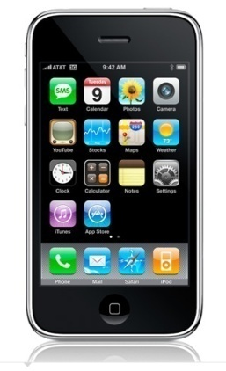


Techniques of implementing Offline Access Offline Access – Current Browser Support
Android 2.0+
Chrome 5.0+
Firefox 3.5+
Opera 10.6+
iPhone 2.1+
Safari 4.0+

Slide 7
Techniques of implementing Offline Access The Cache Manifest
An offline web application revolves around a cache manifest file
A manifest file is a list of all of the resources that your web application might need to access while it’s disconnected from the network
In order to bootstrap the process of downloading and caching these resources, you need to point to the manifest file, using a manifest attribute on your <html> element
Your cache manifest file can be located anywhere on your web server, but it must be served with the content type text/cache-manifest
Every one of your HTML pages points to your cache manifest file, and your cache manifest file is being served with the proper Content-Type header
A manifest file can have any file extension, but needs to be served with the correct mime-type i.e. text/cache-manifest
Notes:
The Cache Manifest File:
The application cache is controlled by a plain text file called a manifest, which
contains a list of resources to be stored for use when there is no network connectivity.
The list can also define the conditions for caching, such as which pages should never
be cached and even what to show the user when he follows a link to an uncached
page.
If the user goes offline but has visited the site while online, the cached resources will
be loaded so the user can still view the site in a limited form. By carefully considering
the contents of your manifest file, you can offer a suitable web experience to a
disconnected user.
Using the cache interface gives your application three advantages:
Offline browsing - Users can navigate through out the site when they're offline.
Speed - Cached resources are local, and therefore load faster.
Reduced server load - The browser will only download resources from the server that have changed.

Slide 8
Techniques of implementing Offline Access Cache Manifest in html Tag
Referencing a manifest file
To enable the application cache for an app, include the manifest attribute on the document's html tag:
The manifest attribute can point to an absolute URL or relative path, but an absolute URL must be under the same origin as the web application
<!DOCTYPE HTML>
<html manifest="/cache.manifest">
<body> ... </body>
</html>
<html manifest="http://www.example.com/example.manifest"> ... </html>
Notes:
The Cache Manifest File:
The manifest attribute should be included on every page of your web application that
you want cached. The browser does not cache a page if it does not contain the
manifest attribute (unless it is explicitly listed in the manifest file itself. This means
that any page the user navigates to that include a manifest will be implicitly added to
the application cache. Thus, there's no need to list every page in your manifest.

Slide 9
Techniques of implementing Offline Access Sections in Cache Manifest
CACHE
The CACHE section is considered the default - i.e., if no section heading has been defined, the browser will assume this is the CACHE section
Beneath this heading, you can list URIs to resources you want the browser to download and cache for offline use, including URIs hosted externally
CACHE:
/html5/src/logic.js
/html5/src/style.css
/html5/src/background.png
http://example.com/css/widget.css

Slide 10
Techniques of implementing Offline Access Sections in Cache Manifest
FALLBACK
The FALLBACK section tells the browser what to serve when the user tries to access an uncached resource while offline
It contains two values per line, separated by a space
The first value is the request URI to match, and the second is the resource sent upon matching
In below given example we’re telling the browser that when an offline user requests a URI matching “/status.html”, it should instead serve the cached file “offline.html”
CACHE MANIFEST FALLBACK: /status.html /offline.html

Slide 11
Techniques of implementing Offline Access Sections in Cache Manifest
NETWORK
Finally, we have the NETWORK section, used to tell the browser explicitly which resources are only available while online
By default, this uses the asterisk * symbol, meaning all resources that are not cached will require a connection
Alternatively we can whitelist specific url prefixes
CACHE MANIFEST NETWORK: *

Slide 12
Techniques of implementing Offline Access The Cache Manifest – Complete Example
CACHE MANIFEST # This is a comment CACHE: /css/screen.css /css/offline.css /js/screen.js /img/logo.png http://example.com/css/styles.css FALLBACK: / /offline.html NETWORK: *

Slide 13
Techniques of implementing Offline Access Triggering Cache Refresh
Once a cache has been successfully downloaded, the browser will retain it until either the user clears the cache or you trigger an update
Triggering an update with your manifest file requires that the contents of that file change, not just the assets themselves
Updating the assets on your server will not trigger a cache update
You must modify the manifest file
If you’re adding or removing resources completely, you’ll have to edit your manifest file anyway
But what if you’re just amending an already cached stylesheet?
Just add in a simple version number comment that you change when you want to trigger an update
Notes:
Triggering Cache Refresh:
Once a cache has been successfully downloaded, the browser will retain those
assets until either the user clears the cache or you trigger an update. Triggering an
update with your manifest file requires that the contents of that file change, not just
the assets themselves.
Updating the assets on your server will not trigger a cache update. You must modify
the manifest file.
If you’re adding or removing resources completely, you’ll have to edit your manifest
file anyway. But what if you’re just amending an already cached stylesheet?
This is where comments come in handy. Just throw in a simple version number
comment that you change when you want to trigger an update:

Slide 14
Techniques of implementing Offline Access Triggering Cache Refresh
Example
The next time you want to trigger a cache refresh, just increment the version number
When the user next visits the online version of a page including this manifest, it will re-download the manifest file, notice the change, download the listed assets, and purge the existing cache
CACHE MANIFEST # Version 9 CACHE: /css/screen.css
Notes:
The next time you want to trigger a cache refresh, just increment the version number.
When the user next visits the online version of a page including this manifest, it will
re-download the manifest file, notice the change, download the listed assets, and
purge the existing cache.
Browser Bug: Firefox caches the manifest file itself and will not update it even if the
manifest has changed on the server. With some server config wizardry, you can tell
browsers that the cache of the manifest file is instantly invalidated and should be
requested from the server every time it’s referenced.

Slide 15
Techniques of implementing Offline Access DEMO
OfflineDemo\index.jsp

Slide 16
Introduction to Drag & Drop API in HTML5 HTML5 – Drag & Drop API
We've been using libraries like JQuery and Dojo to simplify complex UI elements
For example animations, rounded corners, and drag and drop
Drag and drop is a first class citizen in HTML5!
Drag and drop is one of the often used functionalities throughout websites for various reasons
The spec defines an event-based mechanism, JavaScript API, and additional markup for declaring that just about any type of element be draggable on a page
Browser support
The latest versions of Firefox and Chrome support this API
Notes:
HTML5 – Drag & Drop API
For years, we've been using libraries like JQuery and Dojo to simplify complex UI
elements like animations, rounded corners, and drag and drop. There's no doubt,
eye-candy is important for making rich, immersive experiences on the web. But why
should a library be required for common tasks that all developers are using?
Drag and drop (DnD) is a first class citizen in HTML5!
Along with an army of JavaScript APIs, HTML5 comes with a Drag and Drop (DnD)
API that brings native DnD support to the browser making it much easier to code up.
The spec defines an event-based mechanism, JavaScript API, and additional markup
for declaring that just about any type of element be draggable on a page.

Slide 17
Techniques of implementing Drag & Drop API How to use Drag & Drop API in HTML5?
Drag & Drop requires only a few things to work:
Something to drag
A drop target
JavaScript event handlers on the target to tell the browser it can drop
The following elements are draggable by default:
<img> elements
<a> elements (with an href).
If you want to drag a different element, you need to set the draggable attribute to true
<div id="word1" draggable="true">the</div>

Slide 18
Techniques of implementing Drag & Drop API How to use Drag & Drop API in HTML5?
Starting a drag operation
When a drag operation on a draggable object begins, a number of things need to be done:
Define the drag effect that is allowed
There are three effects that can be allowed:
copy —indicates that the item being dragged will be copied
move —indicates that the item being dragged is to be moved
Link —indicates that some sort of relationship is to be created between the original item and the resultant one
Whilst the item is being dragged, the drag effects can be altered to indicate that certain effects are allowed at certain locations
Set the data that is to be dragged using setData on the dataTransfer object
Define the drag image using setDragImage, if it's to be customized

Slide 19
Techniques of implementing Drag & Drop API DEMO
Drag-Drop-API\imageTransfer.html

Slide 20
Limitations of HTML5 Limitations of HTML5
The HTML5 spec is DRAFT and is in ongoing development (change)
Video support is not standardized
Not currently a single codec that all browsers will support
Currently no support for cue points or alpha (transparent) video
Limited desktop browser support
Only the newest and best have reasonable support
Internet Explorer will not have decent support until IE9
Challenges getting consistent page display across browsers
Graceful page degradation is potentially complex
Currently no designer tools for creating HTML5 animation or interactivity (all must be implemented by a developer)
Limited developer debugging tools

Slide 21
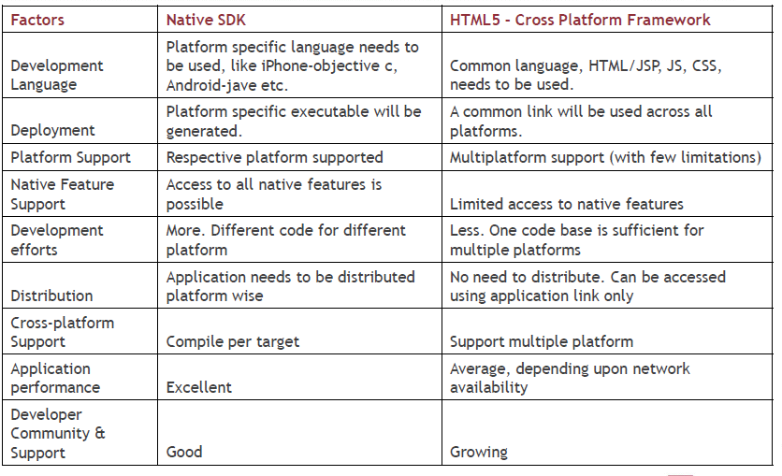
Comparison Comparison of Native SDK & HTML5

Slide 22

Summary
In this module, you have learnt:
HTML5 introduces new methods for enabling a web site or web application to function without a network connection
All browsers have caching mechanisms, but they're unreliable and don't
Always work as you might expect
An offline web application revolves around a cache manifest file
It contains a list of resources to be stored for use when there is no network connectivity
HTML5 comes with a Drag and Drop (DnD)
API that brings native DnD support to the browser making it much easier to code up

Slide 23

Review Question
Fill in the blank
A _____________ file is a list of all of the resources that your web application might need to access while it’s disconnected from the network
The ____________ section tells the browser what to serve when the user tries to access an uncached resource while offline
State whether True/False
Drag & Drop API is used for developing web pages which can have draggable items
The <img> & <a> elements are by default draggable items in HTML5

